Slide 1
New Diversity Discovery Class Curriculum
Youth Discovery Inc

Slide 2
Youth Discovery Inc, Mission
In 2013 we focused helping Latino, minority & low-income students achieve their highest potential through:
Service
Leadership
Mentorship
Self-Identity Development
Diversity Appreciation
Post-High School Skills
Financial Aid

Slide 3
The Facts, High School Drop Out Rates

Slide 4
YDI’s 2012-2013 Successes
Youth Discovery served over 2000 people in 2012-2013.
100% high school graduation and a 100% college matriculation rate.
We want to replicate our success rates to all Latino and minority students, not just the few.
We helped students raise an estimated$150,000, between scholarships and financial aid.

Slide 5
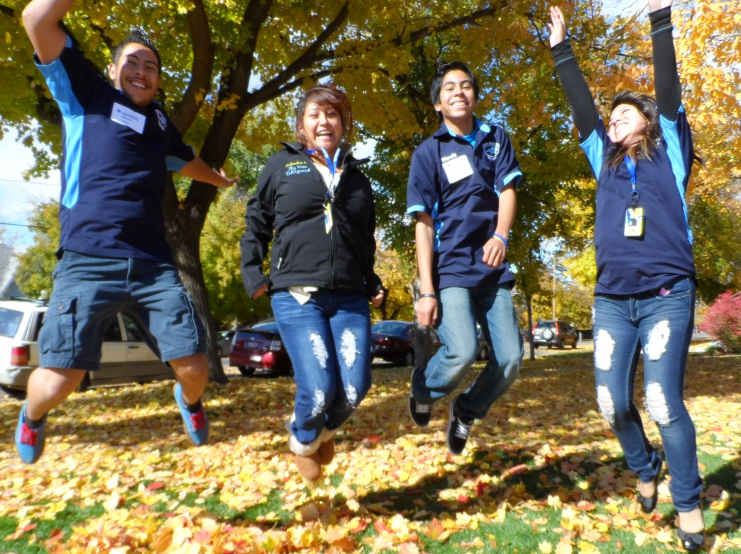
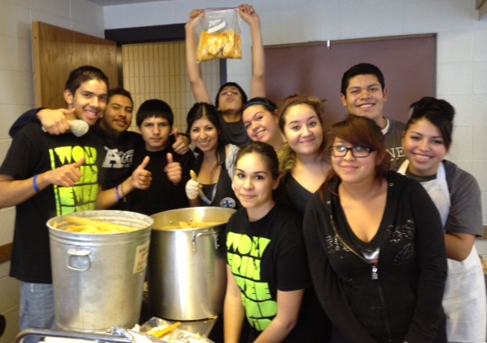
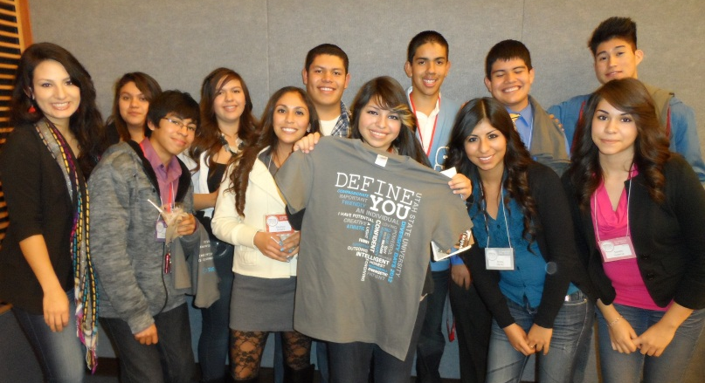
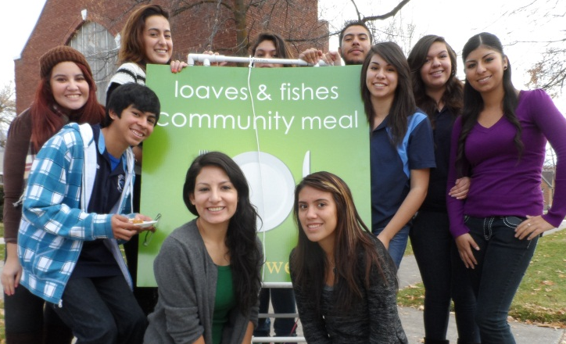
Success Stories
Latinos in Action at Sky View
Tamales for Tuition at Sky View
Define You Project
Service at Loaves & Fishes

Slide 6
Diversity Discovery Class
THE NEW DIVERSITY DISCOVERY CLASS CURRICULUM WILL TRANSMIT OUR SUCCESS TO OTHER LATINOS, MINORITIES, AND
LOW-INCOME STUDENTS.
Create new partnerships. (College of Education, GEAR UP, CoolSpeak, Office of Multicultural Affairs)
Impact more families and communities.
Learn, Serve, Lead.
Change perspectives.

Slide 7
Budget

Slide 8
Why Youth Discovery Inc?
Supportive board includes educators, community members, students, business people, strategists, activists, and consultants.
Experience in the needs of Latino and minority youth.
Passionate leadership and school administration.
“Sustainable Turnover” paradigm for our programs.
Cultivating young diverse leadership.

